Slide 1
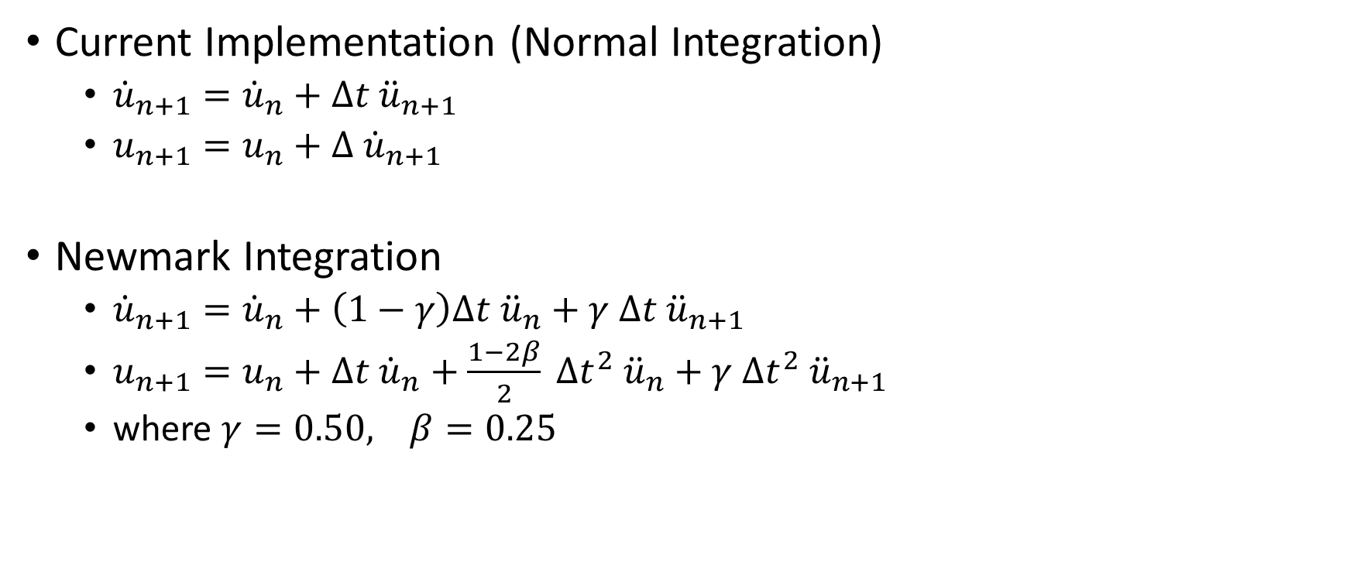
Newmark Integration
Current Implementation (Normal Integration)
${\dot{u}}_{n+1}={\dot{u}}_{n}+Δt {\ddot{u}}_{n+1}$
$u_{n+1}=u_{n}+Δ {\dot{u}}_{n+1}$
Newmark Integration
${\dot{u}}_{n+1}={\dot{u}}_{n}+\left(1−γ\right)Δt {\ddot{u}}_{n}+γ Δt {\ddot{u}}_{n+1}$
$u_{n+1}=u_{n}+Δt {\dot{u}}_{n}+\frac{1−2β}{2} Δt^{2} {\ddot{u}}_{n}+γ Δt^{2} {\ddot{u}}_{n+1}$
where $γ=0.50, β=0.25$

Slide 2
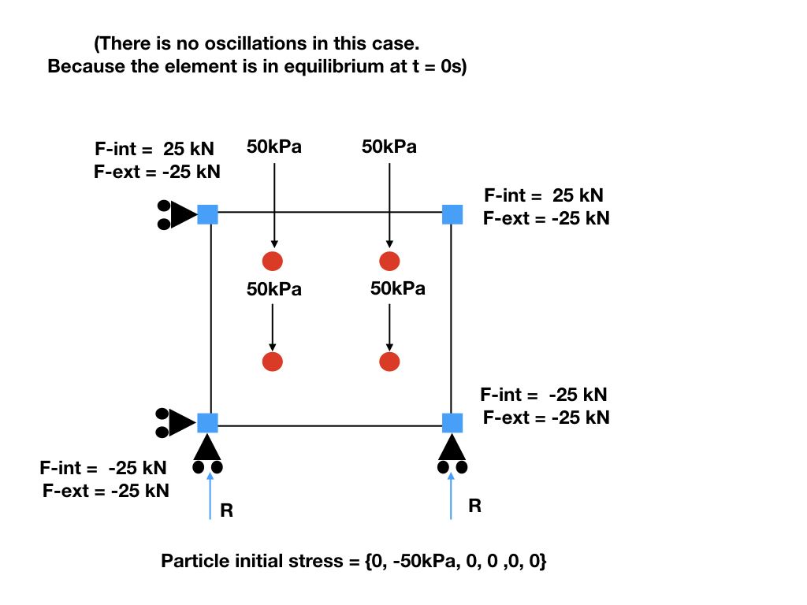
N3
N2
P2
P3
P0
P1
N0
N1
No initial stress would lead to oscillation
Figure made by Shyamini Kularathna
Modified by Ezra Setiasabda

Slide 3
Results of Element Test

Slide 4

Results of Element Test (Effects of $γ$)

Slide 5

Results of Element Test (Effects of $β$)

Slide 6
Column Colapse

